Slide 1


Analyzing Sports Performance Using Player Metrics
Guided By:
Dr. S. Renuga(Professor)
Subject:- CSA1606 – Data Warehousing and Data Mining
Presented by:-
Sk. Sameer – 192372288 Roshan Jameer SD – 192372139 Haleem Sagar – 192372 P. Bharath Kumar Reddy - 192372050

Slide 2
INTRODUCTION
Player metrics give clear numbers to judge how well an athlete is performing, instead of only using opinions.​
Performance data allows coaches to identify strengths,weaknesses and skill gaps in players.
Using data makes training plans and match strategies more logical and evidence‑based, not just guesswork.​
Metrics show performance for single players and for the whole team, so overall statistics can be improved.​
Tracking workload and physical data supports injury prevention and long‑term performance improvement for all levels of sport.

Slide 3
Abstract
Build a simple system that measures players using numbers, so evaluation is objective and not only based on coach opinions.​
Collect important match data for each player like speed, stamina, goals, passes, and defensive actions from scorecards or tracking devices.​
Clean this data by removing errors or blanks, making units similar, and arranging it neatly player‑wise and match‑wise in tables.​
Use basic statistics and machine‑learning methods such as K‑Means and regression to group similar players and find what improves performance.​
Show results in clear dashboards with charts so coaches can quickly see who is strong who is weak, and plan training or team selection.

Slide 4
Problem statement
Many players do not receive feedback that is directly linked to their actual match and training data.
When performance is not tracked properly, it becomes harder for players to see progress and fix weaknesses quickly.
Coaches may rely on guesses or past impressions instead of clear statistics when selecting teams or planning tactics.
If data is collected irregularly or using different methods, it can give a wrong picture of how players are performing.
Without detailed data, training plans are usually generic and not personalized to each player’s specific needs.

Slide 5
Literature review
Year | Author | Method | Outcome
2023 | Kumar et al. | Decision Tree, Naïve Bayes | Attendance and marks affect performance
2024 | Sharma et al. | Random Forest, SVM | Random Forest gave higher accuracy
2024 | Thompson et al | Radar & Heatmap visuals | Enhanced performance interpretation
2025 | Patel et al | Predictive modelling | 15–20% improvement in outcome prediction
2025 | Lee & Park, | Random Forest, clustering | Enhanced team strategy and evaluation

Slide 6
MODULE - 1
Data Collection & Preprocessing
Choose the most important numbers for each player, such as speed, stamina, scoring rate, and passing accuracy.​
Take these values from different places like open datasets, wearable sensors, and official match scorecards or statistics websites.​
Clean the dataset by removing rows with missing values, deleting duplicates, and fixing any obvious errors in the records.​
Convert all metrics to a common scale (for example, per match or per 90 minutes) so that players can be compared fairly.​

Slide 7
MODULE -2
Performance Metrics Analysis
Physical metrics help monitor fitness levels and overall athletic conditioning.
Technical metrics reflect a player’s skill accuracy and execution quality.
Tactical metrics support understanding of game awareness and team coordination.
Performance trends help coaches adjust training intensity and focus areas.
Data trends assist in predicting future performance outcomes.
Metrics-based evaluation supports fair player comparison.
Analytical insights improve both individual and team development.

Slide 8
MODULE-3
Data Visualization & Dashboard Development
Data visualization turns complex player metrics into easy-to-understand charts and graphs.
Bar charts and line graphs help compare player performance and track trends over time.
Match wise scoring maps show player score and positioning after during matches.
Dashboards combine multiple metrics into one interactive interface for coaches.
Dashboards provide real-time updates and alerts on player performance and fatigue.

Slide 9
Objectives
Quantify player performance with speed, stamina, accuracy, and scoring efficiency for objective assessment.
Use statistics and machine-learning methods to convert raw match data into reliable player ratings.
Apply clustering algorithms to group players with similar performance profiles for targeted coaching.
Create radar charts and dashboards to visualize multidimensional strengths and weaknesses clearly.
Support fair, transparent team selection decisions by relying on reproducible data-driven analytics.

Slide 10
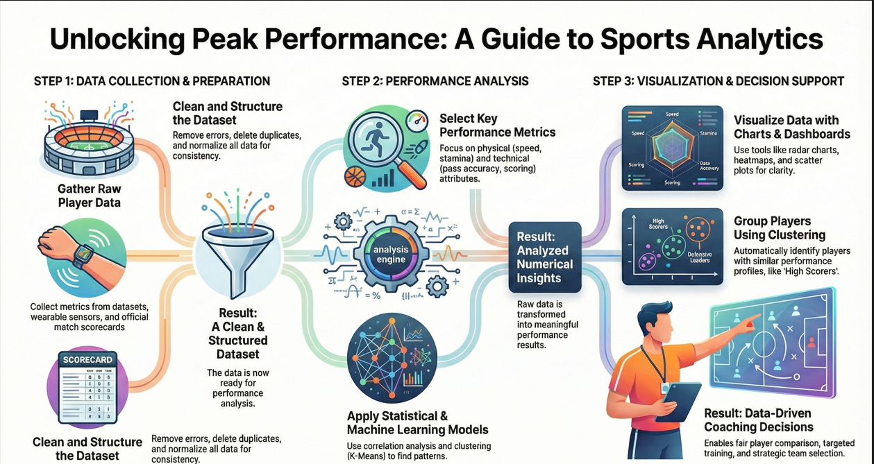
System Architecture

Slide 11
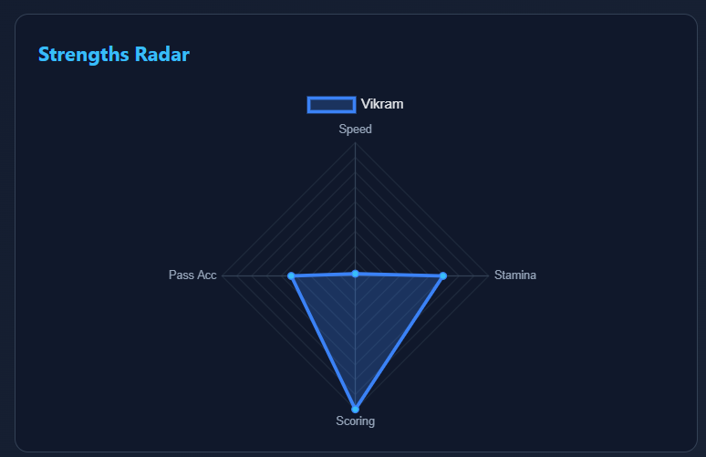
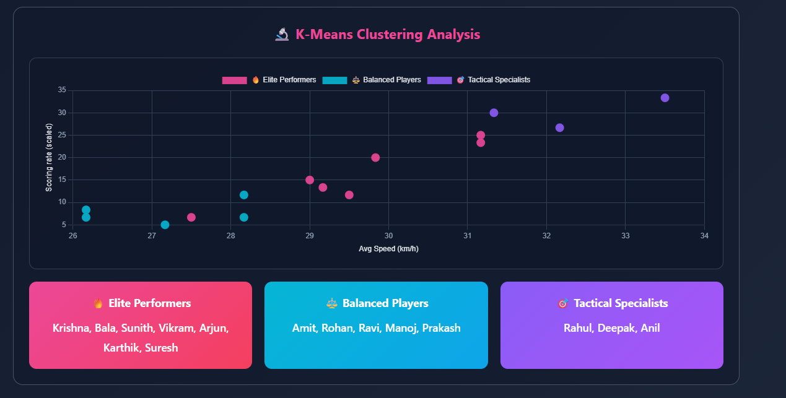
OUTPUT
Speed, Stamina, Scoring, and Pass Accuracy Using
Strengths Radar
“Player Grouping by Speed and Scoring Using
K-Means Clustering”
Strengths Radar

Slide 12
RESULTS & DISCUSSION
The analysis highlighted important metrics like speed, passing accuracy, and scoring efficiency that strongly influence a player’s success.
Visual charts clearly separated high and low performers, making strengths and weaknesses easy to understand.
Radar and heatmap charts allowed fair, evidence‑based comparison of players across multiple skill dimensions at once.
Clustering methods grouped players with similar performance patterns, supporting better team selection and role assignment.
These data‑driven insights reduced personal bias and supported more consistent, accurate coaching decisions.

Slide 13
CONCLUSION
Player performance becomes more accurate when based on numerical data and analytics instead of only human eye judgment.
Important performance factors such as speed, accuracy, stamina, and scoring ability directly influence how well a player performs in matches.
Visual dashboards convert big performance tables into clear charts that coaches can read and interpret quickly.
Radar charts show each player’s strengths and weaknesses across many skills in a single, easy graphic.
Clustering methods automatically group players with similar performance levels or styles, helping role and squad decisions.
Overall, data-driven evaluation reduces personal bias, allowing coaches to make fair decisions, select better teams, and plan stronger match strategies.

Slide 14
Future Enhancement
Integrating live match feeds allows continuous monitoring of player performance, supporting in‑game feedback and tactical adjustments.​
Adding injury-risk prediction and fitness monitoring helps control player workload, avoid overtraining, and reduce long-term injuries.​
Using advanced machine learning models, such as deep learning and ensemble methods, improves prediction accuracy for players and team results.​
Including psychological factors and tactical behavior creates a more complete and balanced view of player performance profiles.​
Building a web or mobile app makes these analytics easily accessible for coaches and analysts anytime, improving practical decision use.

Slide 15
REFERENCES
Pietraszewski, P., et al. (2025). The Role of Artificial Intelligence in Sports Analytics: A Systematic Review. Applied Sciences, MDPI.
Jia, X., et al. (2025). Deep Learning in Sports Performance Analysis. BMC Sports Science, Medicine and Rehabilitation.
Zaręba, K., et al. (2025). Machine Learning-Based Evaluation of Player Performance in Football. Journal of Big Data.
Kovalchik, S. (2023). Player Tracking Data and Performance Metrics in Sports. Annual Review of Statistics and Its Application.
Scientific Reports (2024). Holistic Player Performance Prediction Using Machine Learning in Basketball.

Slide 16
THANK YOU

